Slide 1
Introduction
A quick breakdown about the creation of SADA Superstore

Slide 2
What we chose
We chose the provided case study for the team project which was to create a software for an on-line supermarket.
The requirement of the case study is to produce a software that meets the four cores, which include loyalty scheme, payment, marketing and supplier interface.
The group is made up five so we produced an additional core which is analytics, which is simply an analysis of the data changes being occurred for the business.
Abdala

Slide 3
Meet The Team
Akber – Project Manager / Supplier
Sabaa – Head Core Developer/ Analytics
Abdala - Marketing
David – Payment
Subodh – Loyalty Scheme

Slide 4
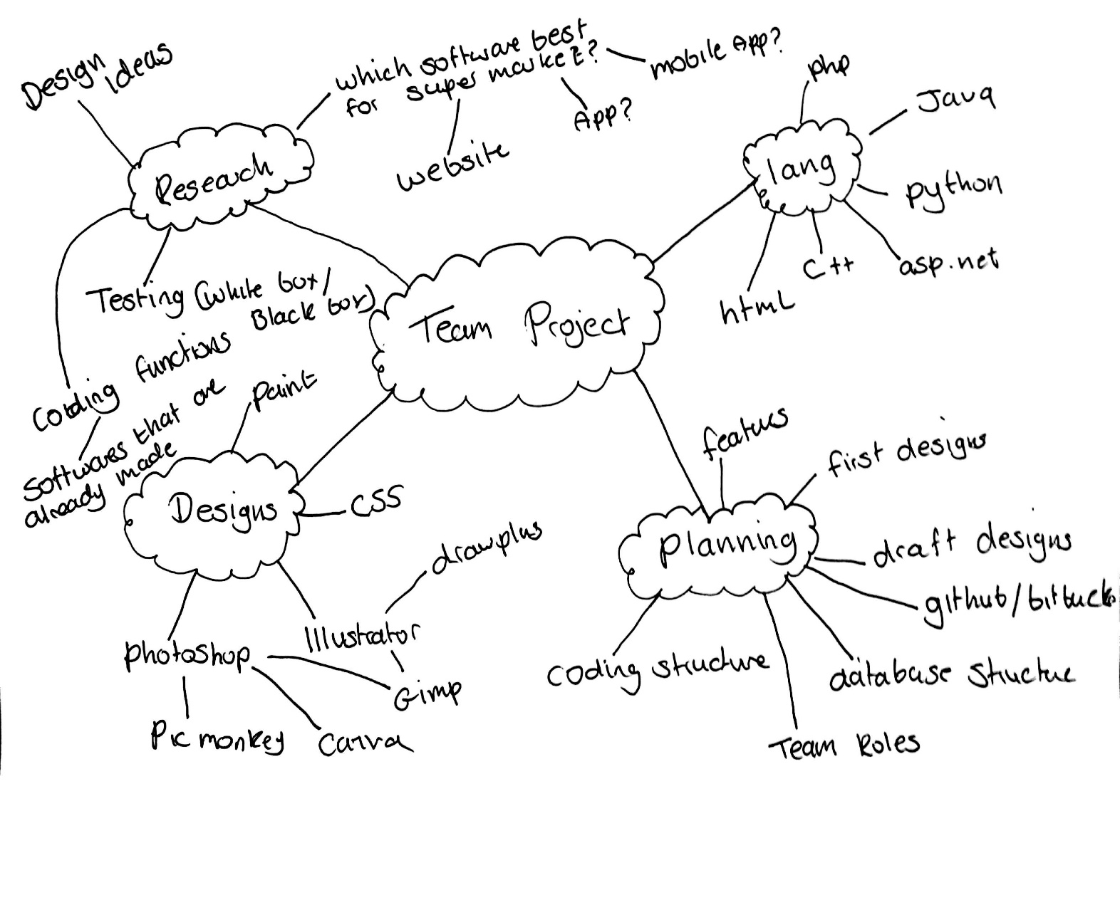
Planning
The course of action we took towards the planning of the project was brain storming.
This was basic but effective as it encouraged group members to provide their ideas and perspective on the project.
SABBA

Slide 5
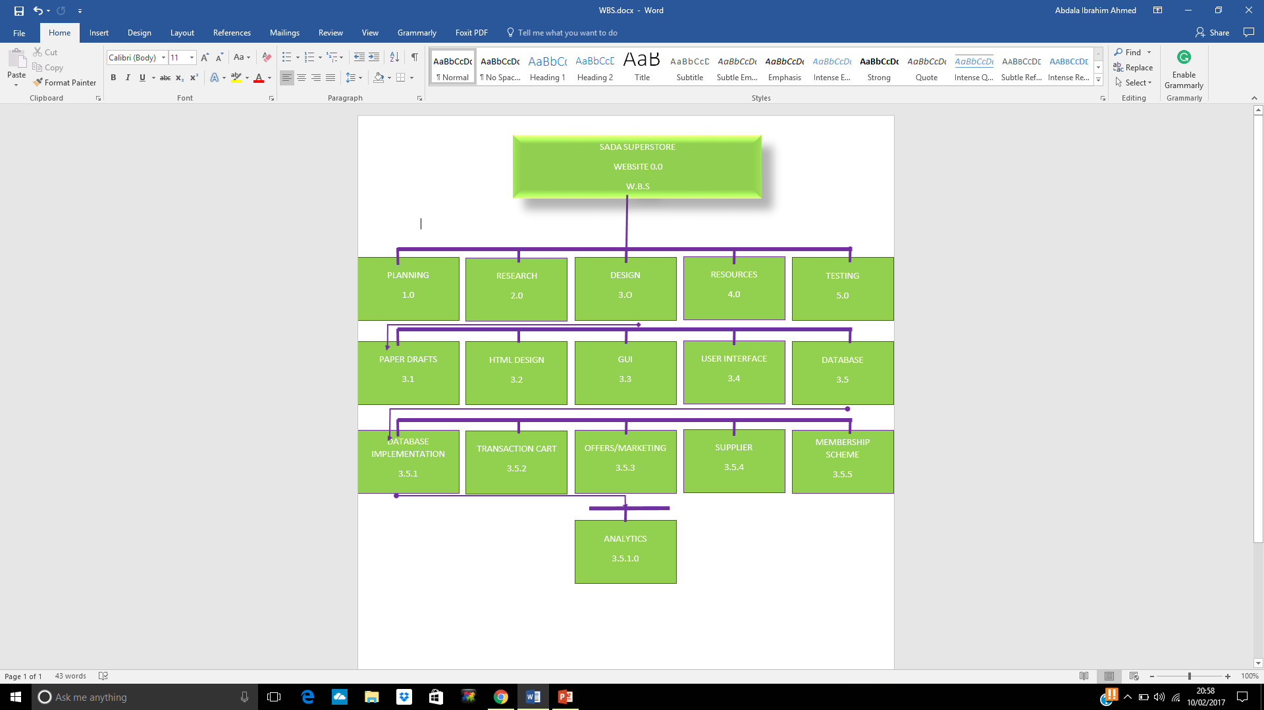
WBS (Work Breakdown Structure)
akber

Slide 6
Head Core Developer / Analytics
Head Core Developer
Website Structure
Database Structure
Quality Assurance
The field of data analysis. Analytics often involves studying past historical data to research potential trends, to analyse the effects of certain decisions or events, or to evaluate the performance of a given tool or scenario.
The goal of analytics is to improve the business by gaining knowledge which can be used to make improvements or changes.
sabba

Slide 7
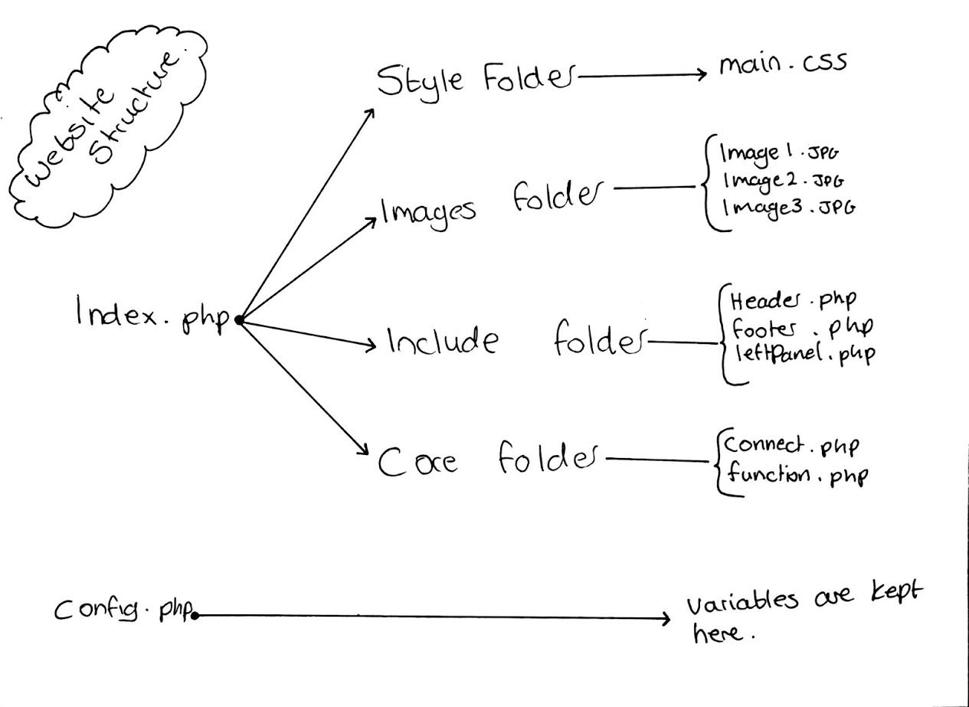

Slide 8
Database
Table names:
Account
Cart
News
Products
Promotions
Purchase_order
Purchase_transactions
Stock
Supplier
Sabba

Slide 9
Cart
Id User_id Cate Product_name Product_code Quantity S_price F_price Discounted
Supplier
Id Name Address Postcode Number
Account
Id Fname Sname Email Address Postcode Number Password Account_type Balance Points
News
Id Title Content Date Banner Account
Stock
Id Product_id Product_type Product_name Product_quantity supplier
Products
Id Name Cate Code Image Price
Purchase_transactions
Id Purchase_id Product_id Product_name S_price quantity
Purchase_order
Id User_id Price Date
Promotions
Id Desc Code Discount Cate
Sabba

Slide 10
Project Manager
Overall responsibility for initiating, planning, design, execution, monitoring, controlling and finalising the project
The ability to ask penetrating questions
Chase up and confirm assumptions
Key roles – planning and setting up variables
Resourcing
Schedules
Managing issues
Leadership
Confidence and assurance
akber

Slide 11
Supplier
Who is a supplier?
Manufacturer, distributor or a vendor
Can ship products to the supplier distribution hubs or directly to the retail store
Reliable and efficient
What is the role of a supplier?
Provide the products to resellers
The relationship between supplier and seller?
Is a very close relationship almost like a food chain between customer, seller and supplier
Responsibilities of a supplier?
Source the seller good products, material and supplier
What is EDI?
Electronic data integration – links databases, allows access between computer systems.
EDI is the best method and shows the trust between the supplier and seller
I am working on creating functions that will retrieve stock levels and update stock by requesting orders from the supplier.
akber

Slide 12
Marketing
Marketing is where a business creates new ways in which it can improve the performance of sales in hopes of increasing profit.
A business can do this by tracking consumer purchase, and by doing so can offer promotions and offers on popular products.
I approached this core by first researching the offers and promotions of other companies such as Tesco and Sainsbury for a better insight.
In doing so it has helped in deciding on offers and promotions that we will integrate into the software.
abdala

Slide 13
Loyalty Scheme
Loyalty Scheme is a rewards program offered by our company to those customers who frequently make purchases in our store. A loyalty scheme program gives our customer advanced access to new products, special sales coupons or free gift voucher to use within our stores.
To benefit form this scheme ,customers have to register their personal information with the our store. After successful registration we issue a unique identifier, such as a numerical ID or membership card so that our customers can use that identifier when making a purchase in our stores.
Research of php and mysql loyalty scheme integration
Alter table accounts to create points column
Gathering resources
Testing
Functions required:
create function to add point
create function to redeem the points to increase balance
subodo

Slide 14
Marketing-Software
[The code will be here along with a screenshot displaying its function and purpose and how it affects the software.]
abdala

Slide 15
Payment
The main idea of Payment development plan: The customer can select a payment option Credit card or PayPal, then select the amount he/she wants to add and uses the money to purchase goods from the website
Research of Php payment integration
Research the payment options Credit card Or PayPal
Gathering resources, code snippets
Functions required:
Add_balance.php
Buy_product.php
Receipt.php
Testing of functions
david

Slide 16
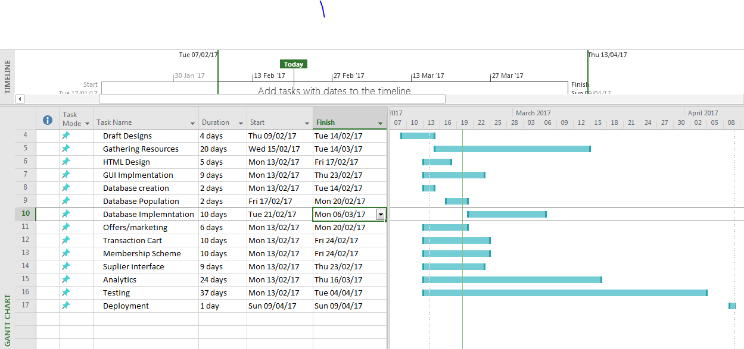
Gantt Chart

Slide 17
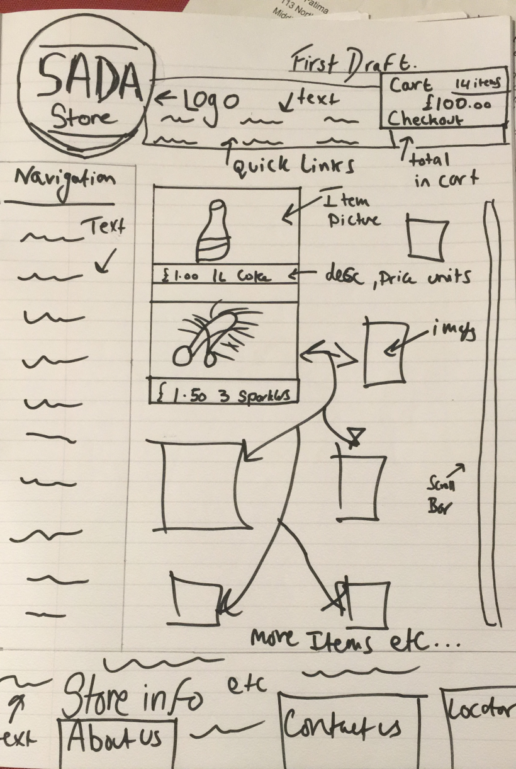
First Design
akber

Slide 18
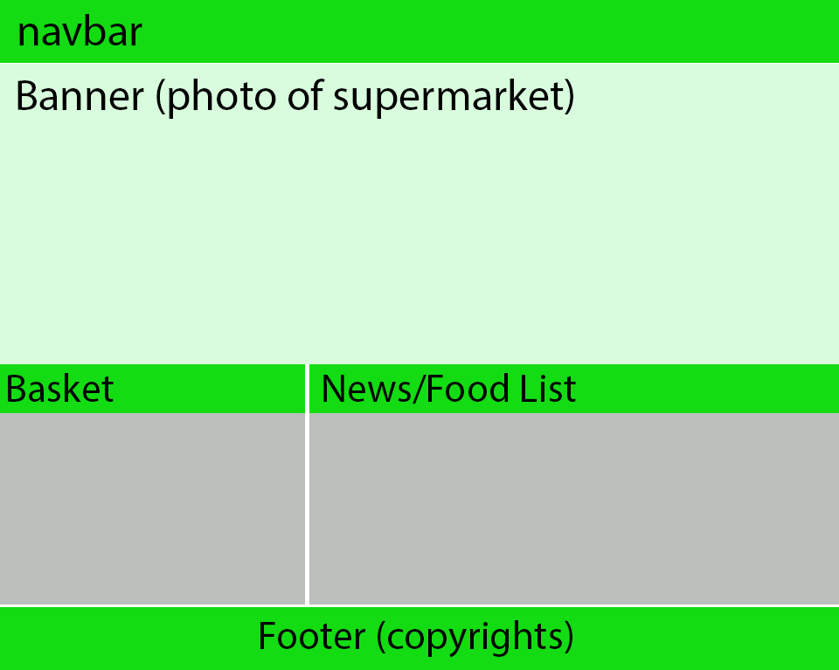
Draft Design
sabba

Slide 19
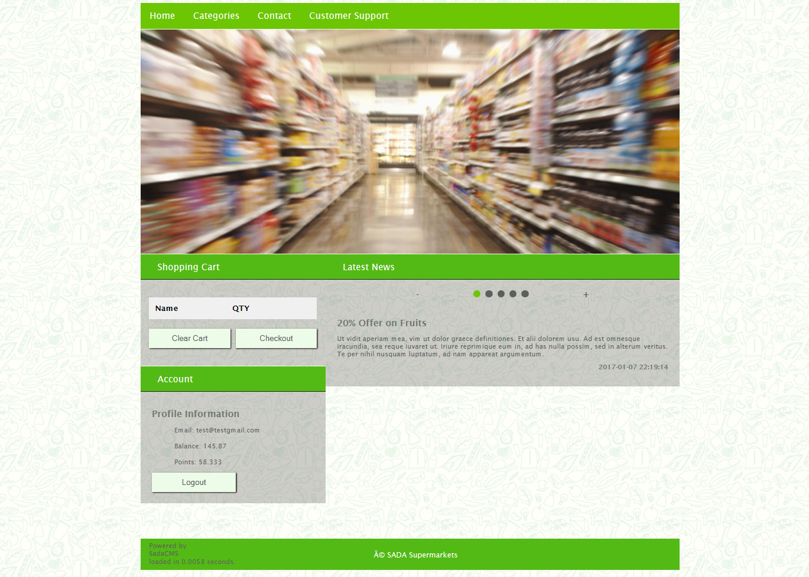
sabba

Slide 20
Thank you for your time
Any Questions ask abdala?
abdala

